Slide 1
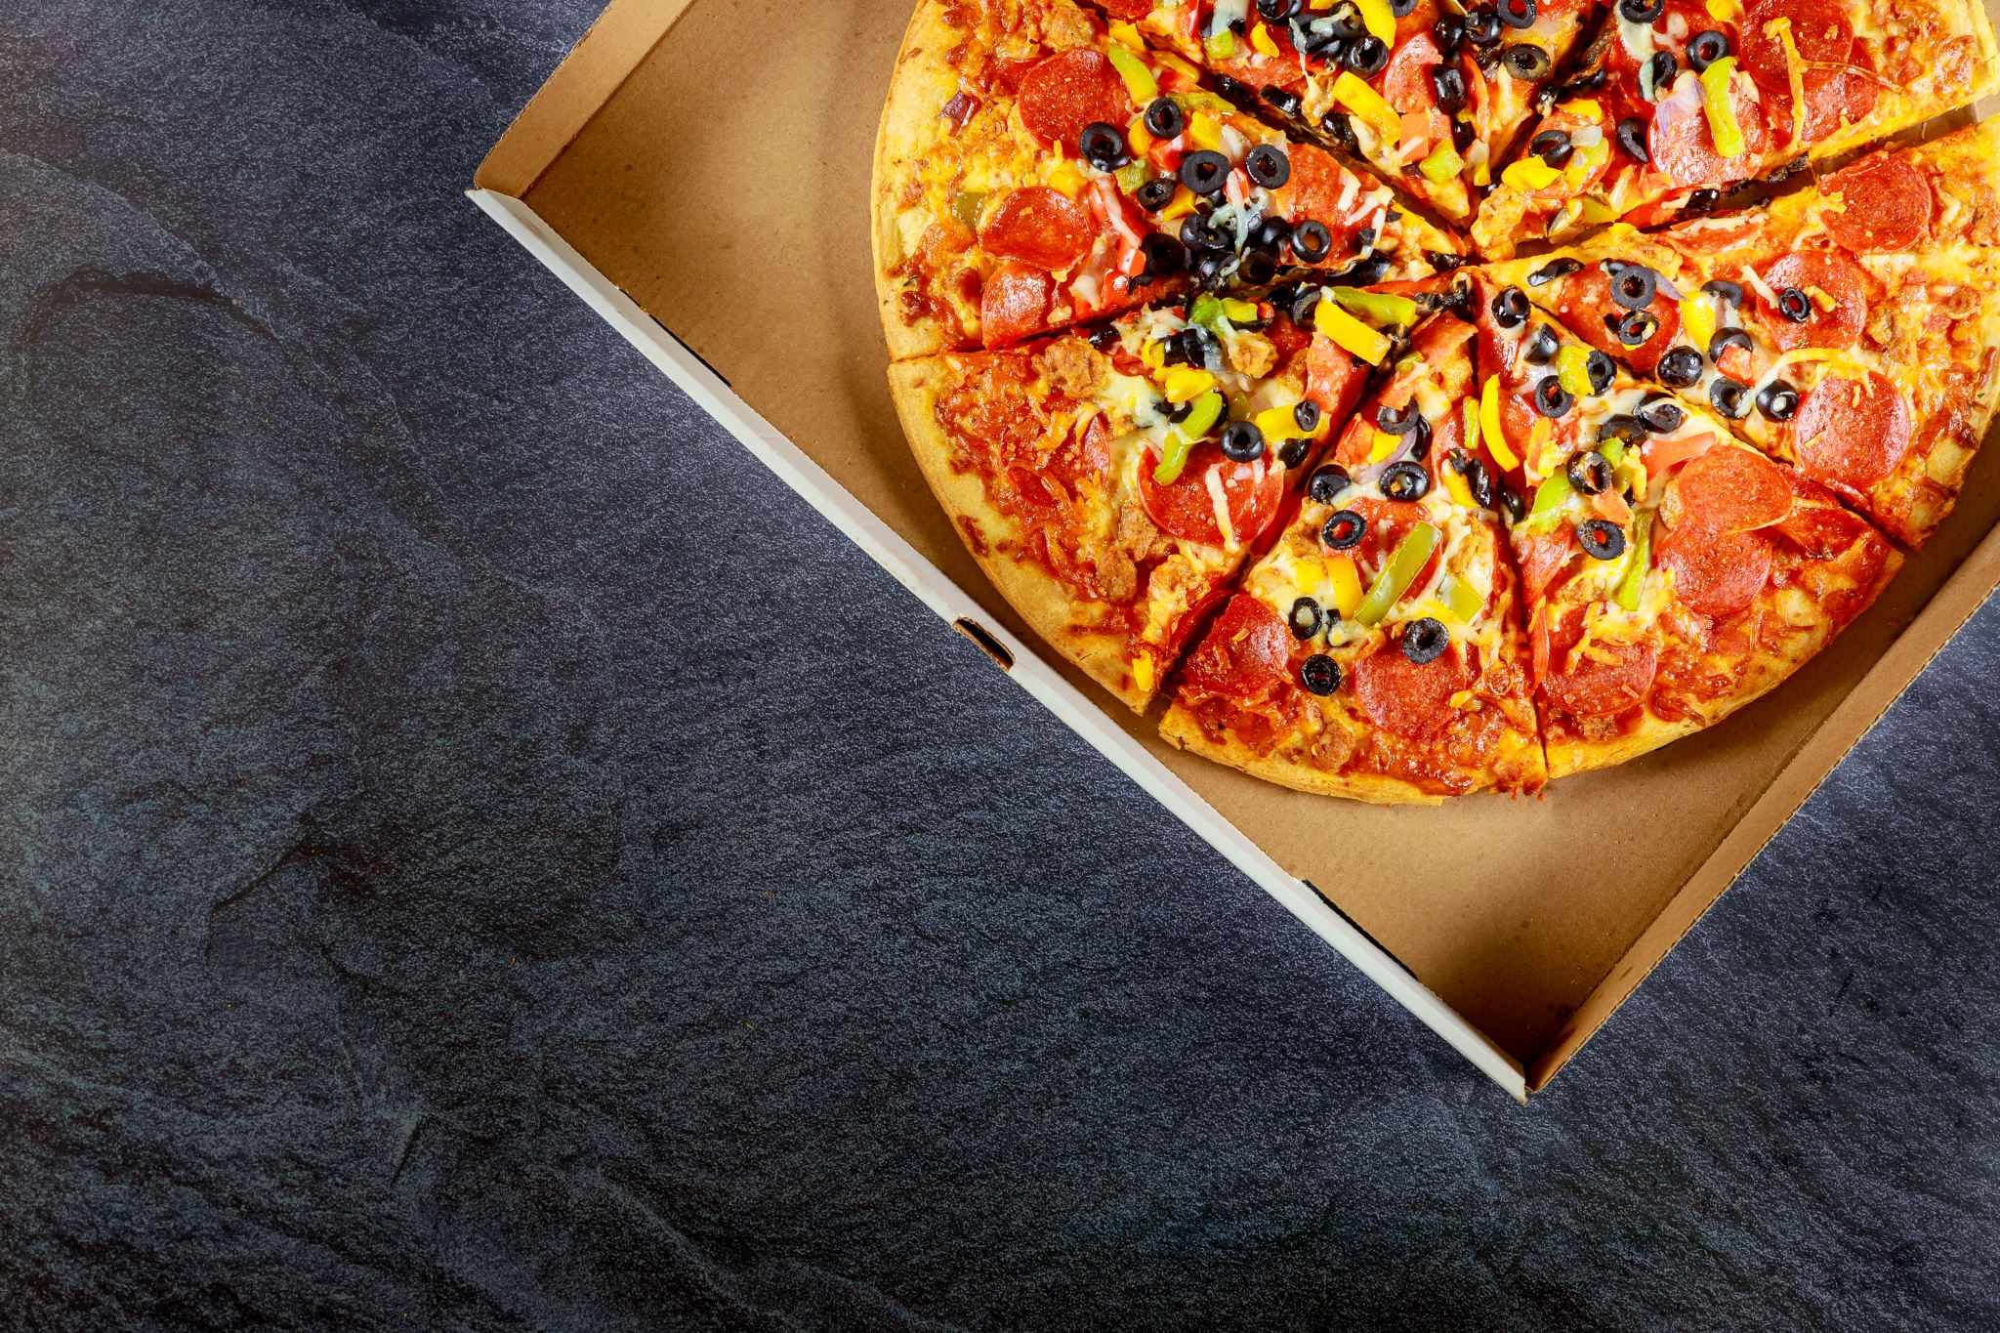
PIZZA SALES REPORT

Slide 2

PROBLEM STATEMENT
KPI requirement
Charts requirements

Slide 3

KPI REQUIREMENTS
Total requirement
Average order value
Total pizza sold
Total order
Average pizza per order

Slide 4
CHART REQUIREMENT
Daily trend for total order
Monthly trend for total order
Percentage of sales by pizza category
Percentage of sales by pizza size

Slide 5

OBJECTIVE
Create a interactive dashboard on power bi inorder to understand the sales trend of the pizza shop.

Slide 6
DATASET ATTRIBUTES
Order_id
Pizza_name_id
Quantity
Order_date
Order_time
Total_price
Pizza_size
Pizza_category

Slide 7
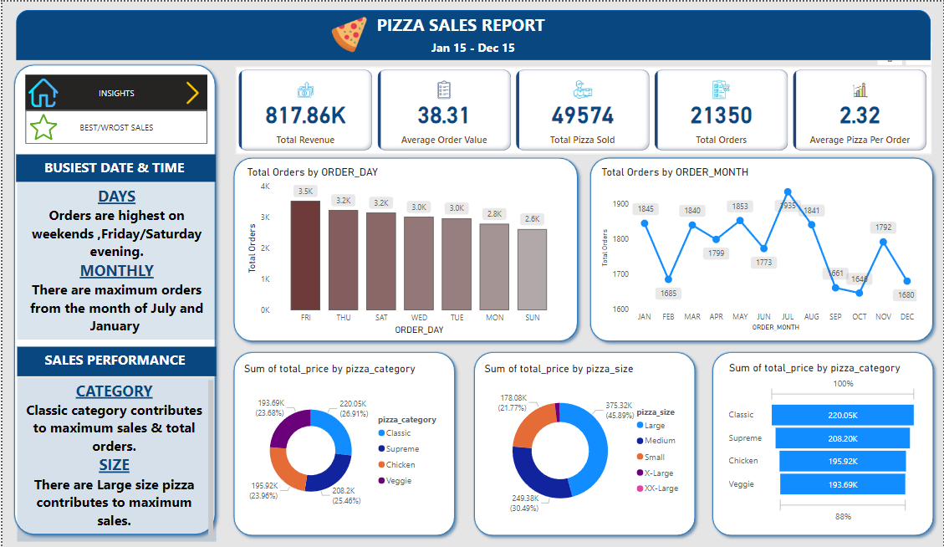
DASHBOARD

Slide 8
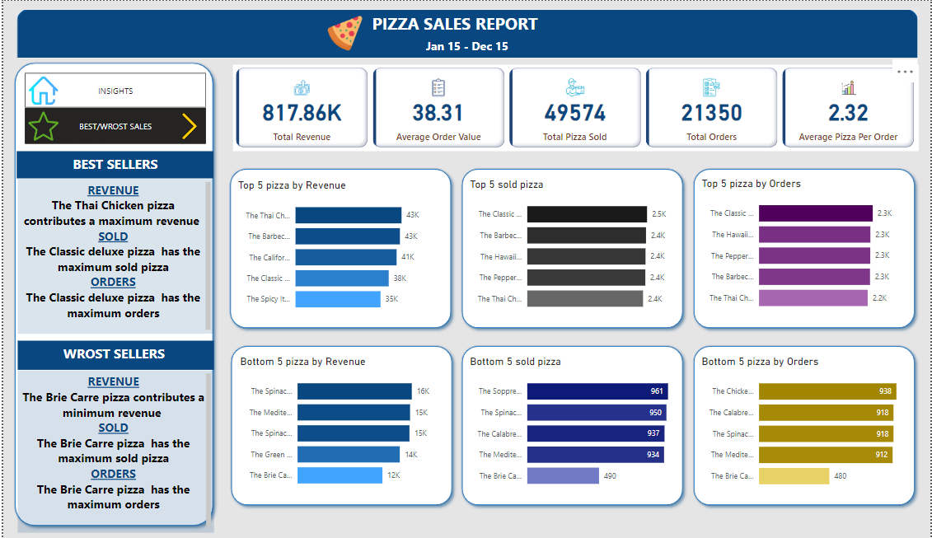
DASHBOARD

Slide 9
INSNSIGHTS
Orders are highest on weekends ,Friday/Saturday evening.
July month having the highest pizza order.
Classic category pizza having the highest sales.
Large size pizza having the highest sales.

Slide 10
INSNSIGHTS
The Thai Chicken pizza contributes a maximum revenue .
The Classic deluxe pizza has the maximum sold pizza and has the maximum orders.
The Brie Carre pizza contributes a minimum revenue and minimum sold pizza and minimum orders.

Slide 11


THANK YOU

